Slide 1


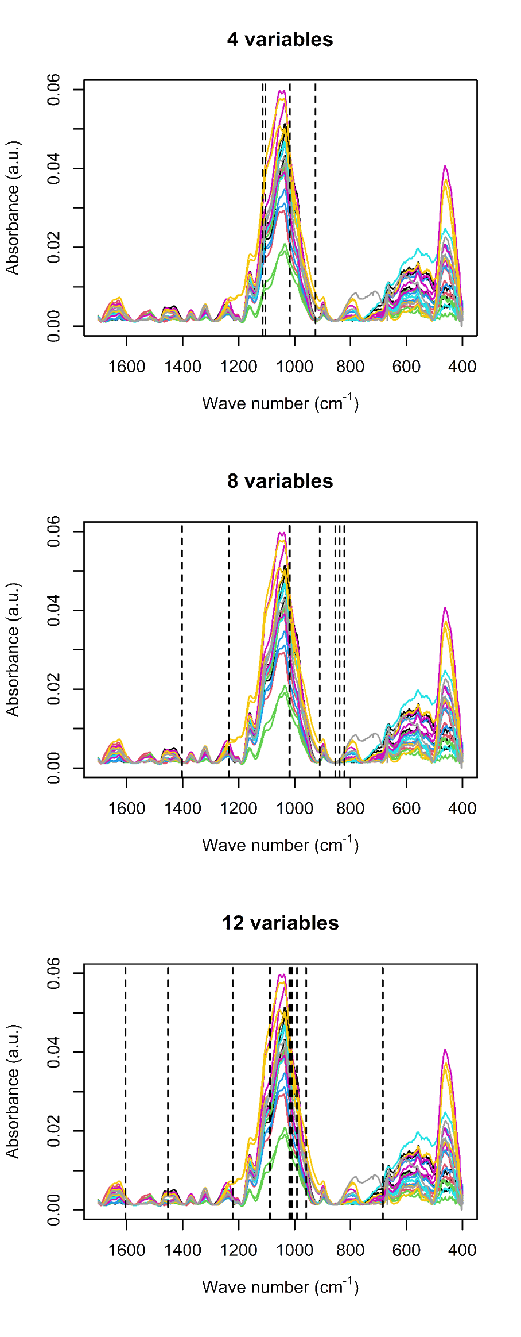
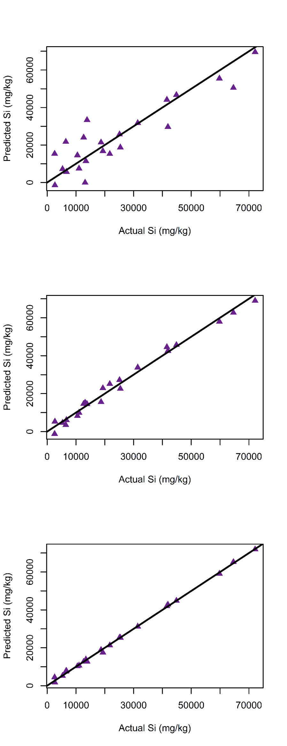

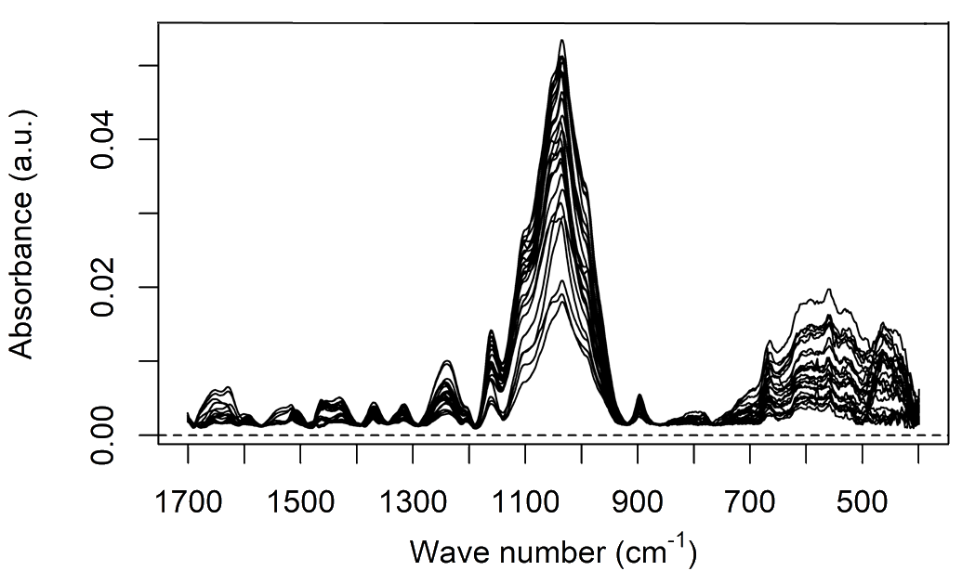
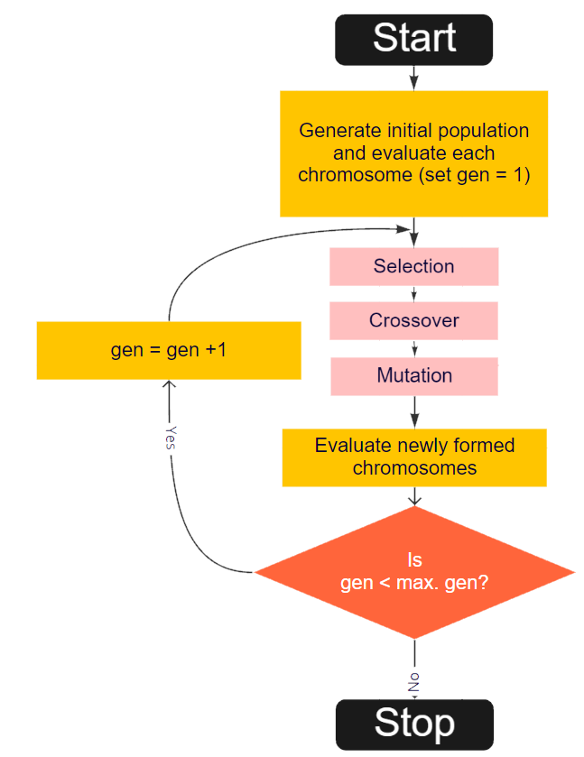
34
20
3
4
20
CONGRESO LATINOAMERICANO DE QUÍMICA
CARTAGENA DE INDIAS - COLOMBIA
CARTAGENA DE INDIAS - COLOMBIA
Determination of Silicon in Wheat Leaves with ATR-FTIR and -Chemometrics
Andrés Beltrán¹; Andrés Cabrera¹, Yohanna Cabrera²
¹ LICE, Departamento de Química, Facultad de Ciencias, Universidad Nacional de Colombia, Bogotá (Colombia)
² Department of Geosciences and Natural Resource Management Forest, Nature and Biomass, university of Copenhagen (Dinamarca)
Results
Objectives
The beneficial effects of silicon for plants have been noticed for more than a century, but only during the last two decades has its role in high productivity agriculture systems been thoroughly studied. The presence of silicon in plants contributes stress-relief mechanisms for environmental events such as drought and pathogen attack. Because of the importance of crops such as wheat, barley, rice, and other grasses that accumulate Si, understanding the relationship between this element and plant science is the focus of numerous scientific efforts. Si quantification is a difficult and costly task, and destructive wet chemistry methods are commonly used. With the recent development of chemometric tools, analysis of silicon in complex matrices have has been proved feasible.
Methods
GA-Selected variables
Regression models
Baseline correction
Variable
selection
Cross-validation and prediction
Figura #: Procedimiento de pre procesamiento de datos.
Aqui una lista de boxplots de los residuals de cada modelo
Aqui una table de p values, significancia de coeficientes y del modelo
Figura #: Cross validated error of prediction vs model complexity
Conclusion
References
[1] Chen, H., Ferrari, C., Angiuli, M., Yao, J., Raspi, C., & Bramanti, E. (2010). Qualitative and quantitative analysis of wood samples by Fourier transform infrared spectroscopy and multivariate analysis. Carbohydrate polymers, 82(3), 772-778.
[2] Varmuza, K., & Filzmoser, P. Introduction to multivariate statistical analysis in chemometrics. CRC press, 2016.
Diagram 1: Genetic algorithm for variable selection

